Slide 1
Depth Map Estimation in 6G mmWave systems
Steve Blandino, Raied Caromi, Jelena Senic

Slide 2





Diversification of applications
Smart Health
Smart Mobility
Smart Home/Cities
Smart Industries
Vital sign monitoring, liveliness detection, fall detection
Traffic monitoring, target classification, autonomous driving, 3D vision, driver sleepiness
Activity/Gesture recognition, 3D vision, presence detection/counting
Autonomous robots/drones, 3D vision

Slide 3






Intelligence for adaptive network
Data rate
Energy Efficiency
Latency
Sensing resolution

Slide 4





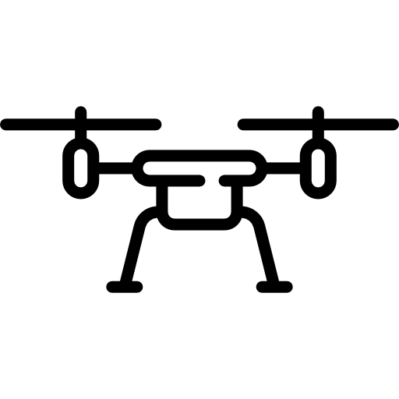

Acquiring multi-dimensional information
Sensor Networks
Integrated Sensing And Communication (ISAC)
IOT
Native multi-dimensional data
Extra hardware investment and power consumption.
Not scalable over large networks.
Source of a massive amount of data
Re-using same hardware and spectrum
Extra processing required to acquire multi-dimensional data

Slide 5

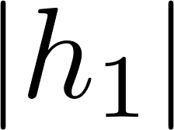

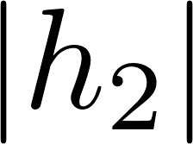
From communication devices to sensors
Integrated Sensing and Communication:
Reuse spectrum, devices and protocols to perform both communication and sensing.
Keep cost and power of future networks under control
Sensing can be performed on communication networks by tracking changes of wireless signals over time.
Time-variations of the wireless signal can be analyzed using signal processing, ML/AI or both.

Slide 6
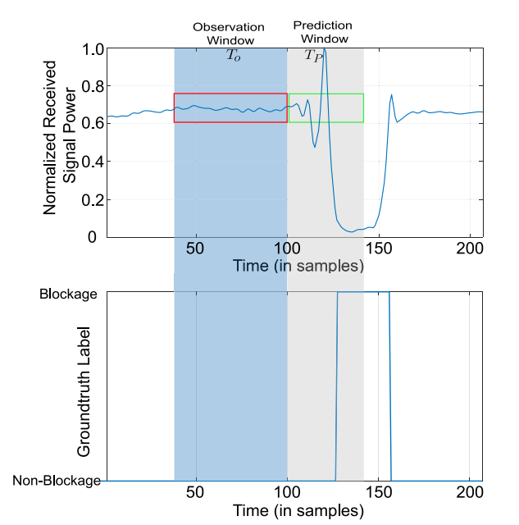
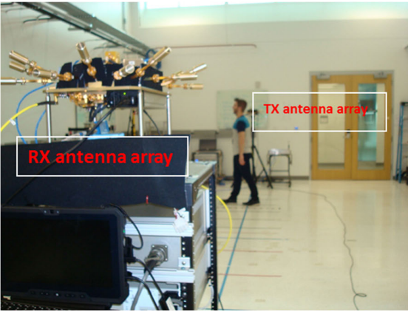
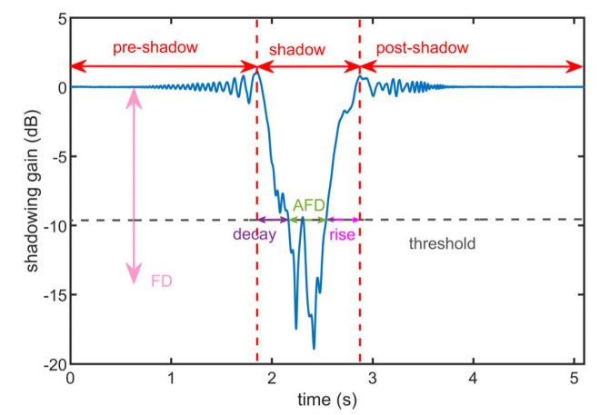

Communication waves to see the physical world
Effect of human presence on 60GHz propagation [1]
Blockage prediction exploiting RF knowledge [2]
[1] A. Bhardwaj, D. Caudill, C. Gentile, J. Chuang, J. Senic and D. G. Michelson, "Geometrical-Empirical Channel Propagation Model for Human Presence at 60 GHz," in IEEE Access, vol. 9, pp. 38467-38478, 2021, doi: 10.1109/ACCESS.2021.3063655.
[2] S. Wu, M. Alrabeiah, C. Chakrabarti and A. Alkhateeb, "Blockage Prediction Using Wireless Signatures: Deep Learning Enables Real-World Demonstration," in IEEE Open Journal of the Communications Society, vol. 3, pp. 776-796, 2022, doi: 10.1109/OJCOMS.2022.3162591.

Slide 7
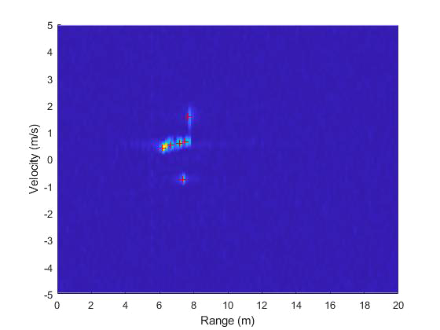
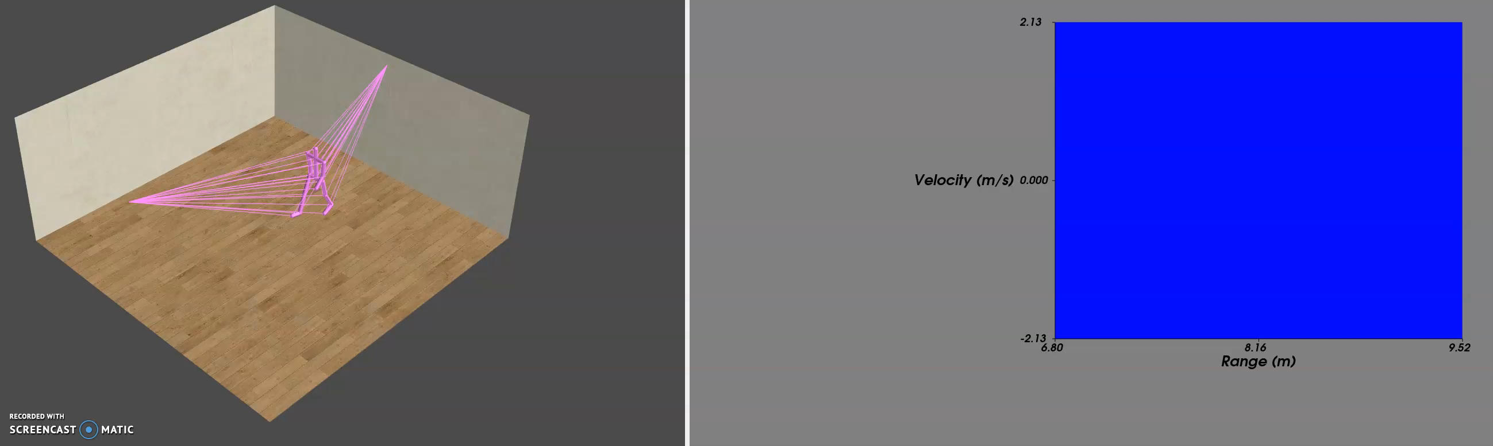
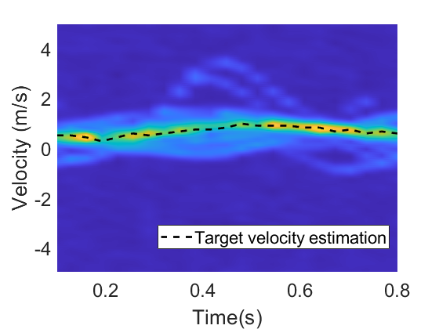
Communication waves to see the physical world
Range/velocity estimation tracking changes of wireless signals over time
WLAN Access Point
WLAN Access Point
Moving target
S. Blandino, et al, "Tools, Models and Dataset for IEEE 802.11ay CSI-based Sensing," 2022 IEEE Wireless Communications and Networking Conference (WCNC), https://github.com/wigig-tools

Slide 8
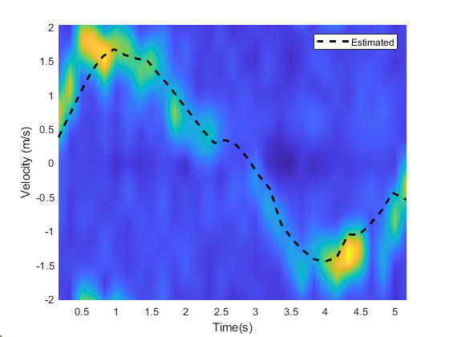
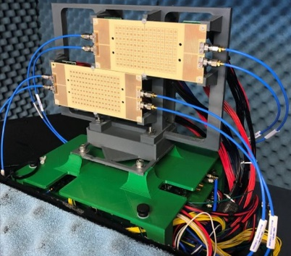
Communication waves to see the physical world
RX
TX
S.Y. Jun, J. Chuang, D. Caudill, C. Gentile, S. Blandino, N. Golmie, “NIST mmWave Phased-Array Channel Sounder for Human Sensing,” Document IEEE 802.11-21/1675r0, Oct. 2021. https://mentor.ieee.org/802.11/dcn/21/11-21-1675-00-00bf-mmwave-phased-array-channel-sounder-for-human-sensing.pptx.
S. Blandino, T. Ropitault, N. Varshney, J. Wang, J. Senic, J. Chuang, C. Gentile, N. Golmie, "DMG/EDMG Link Level Simulation Platform," Document IEEE 802.11-22/0803r0, May 2022. https://mentor.ieee.org/802.11/dcn/22/11-22-0803-00-00bf-dmg-edmg-link-level-simulation-platform.pptx

Slide 9
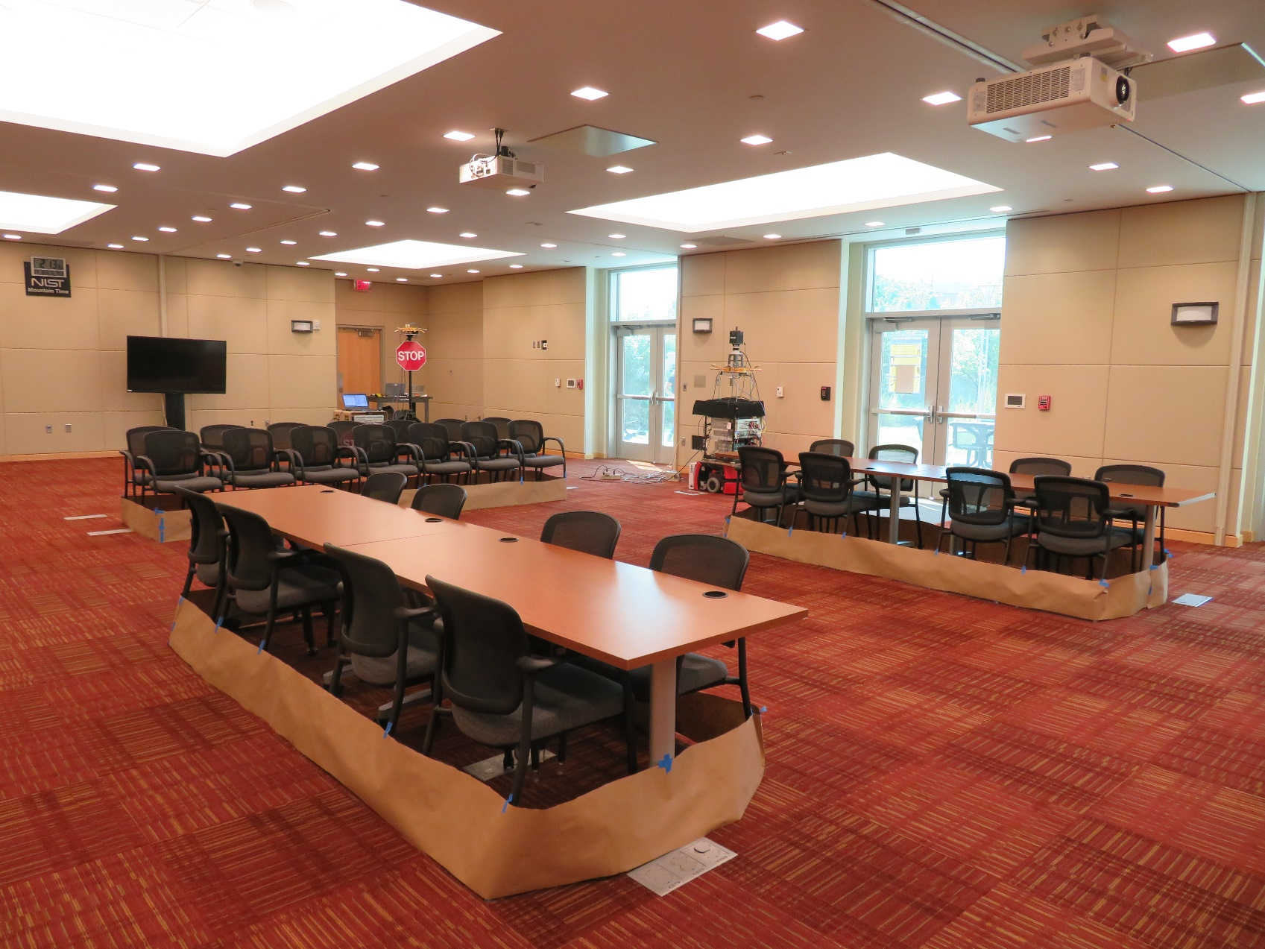
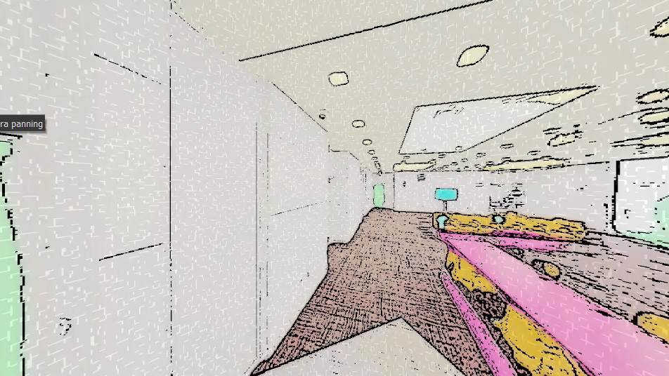
Communication waves to create a digital world
Physical world
Digital world
ISAC + AI/ML

Slide 10
Physical solutions in the digital world
Physical world
Digital world
ISAC + AI/ML
Inference
Simulation, verification, prediction, control…

Slide 11
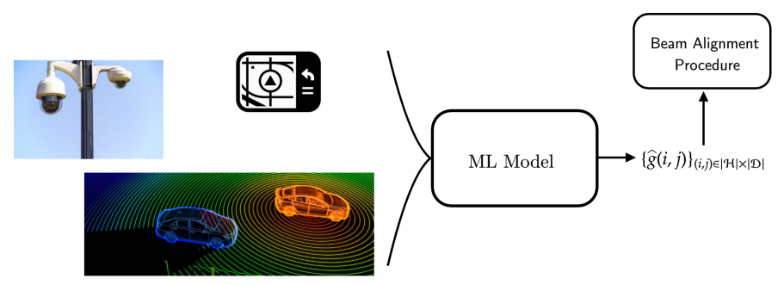
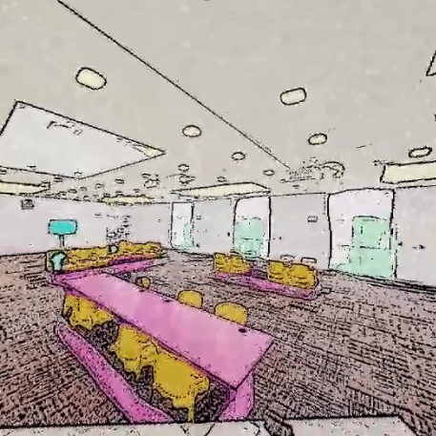
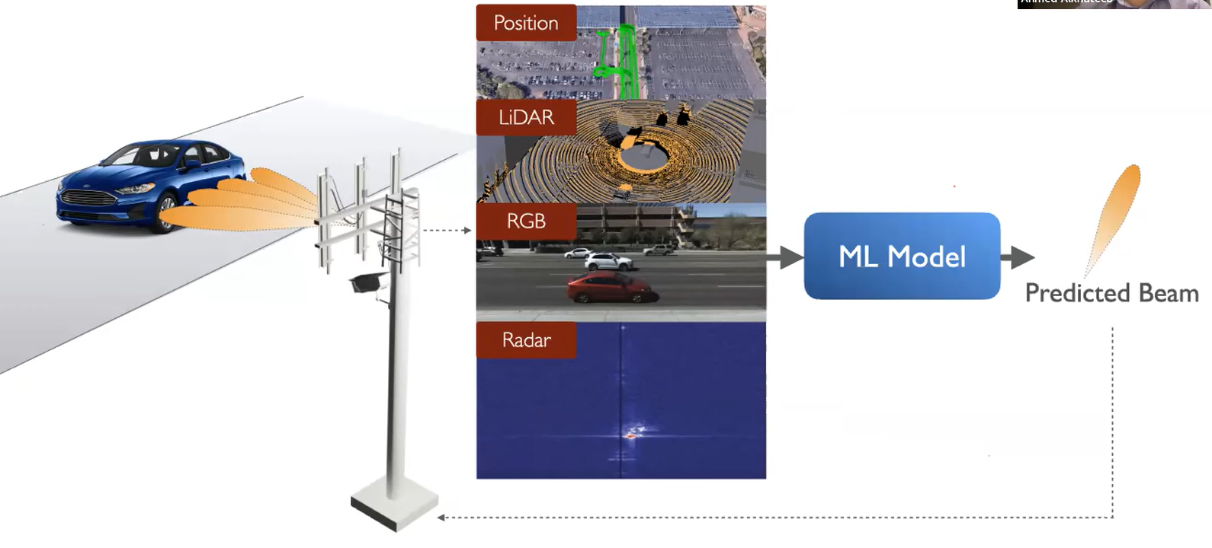
Example: beam selection at millimeter wave
Traditional RF
Sensor Networks + ML/AI
ISAC Networks + ML/AI
Physical world
Digital world
SSW
AI-Aided mmWave Beam Selection for Vehicular Communication, ITU ML/AI in 5G 2020
SSW
SSW
SSW
SSW
Multi-modal sensing aided beam selection, ITU ML/AI in 5G 2022
SSW

Slide 12

Sensor data to design ML/AI models
IOT
Sensor Networks
ISAC Networks
Training ML/AI Models
Inference using RF communication signal

Slide 13
NIST Measurements

Slide 14

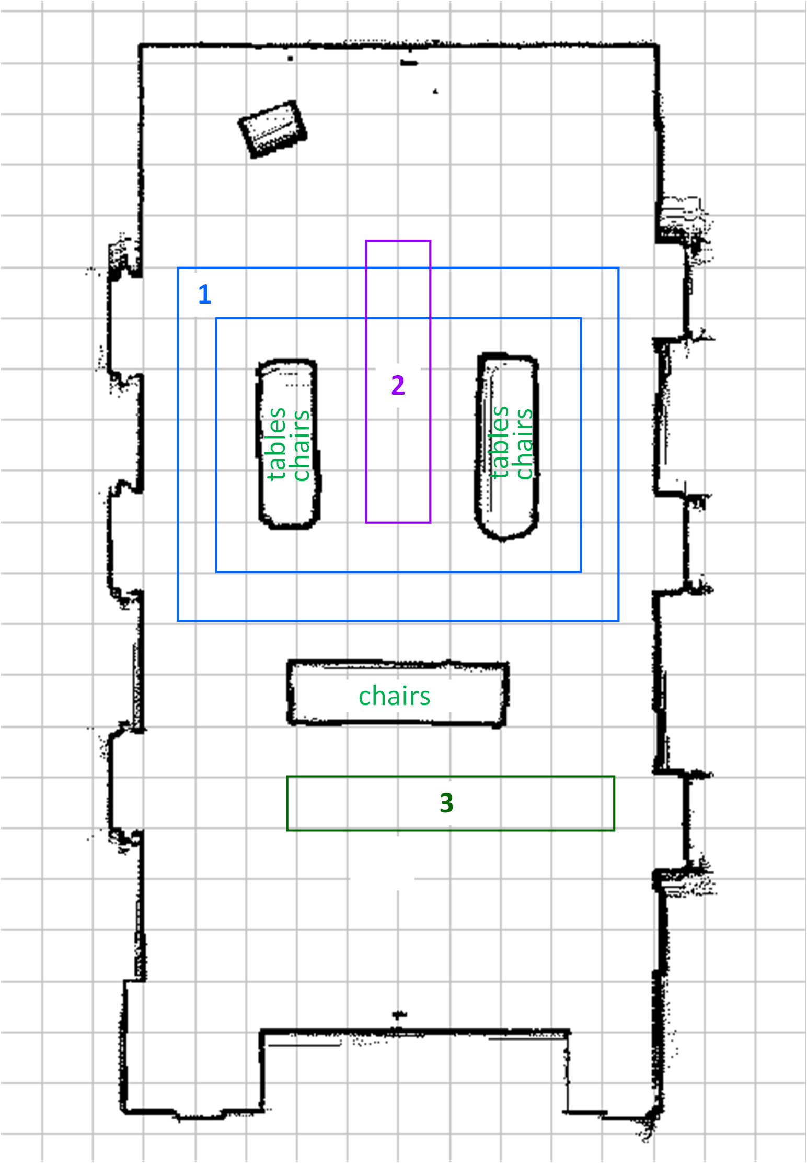
Measurement Environment
Receiver
trajectory
Transmitter
Receiver
Transmitter
The transmitter was fixed in the corner of the room, while the receiver was moving in three areas across the room.

Slide 15
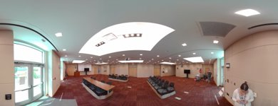
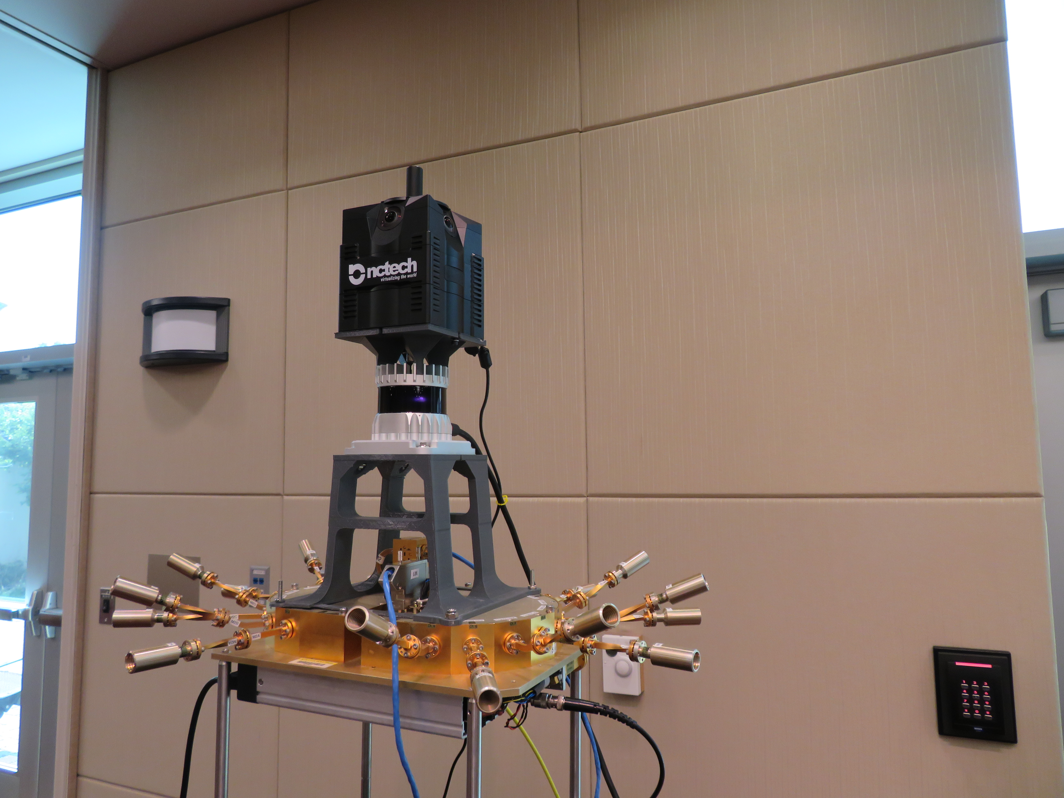
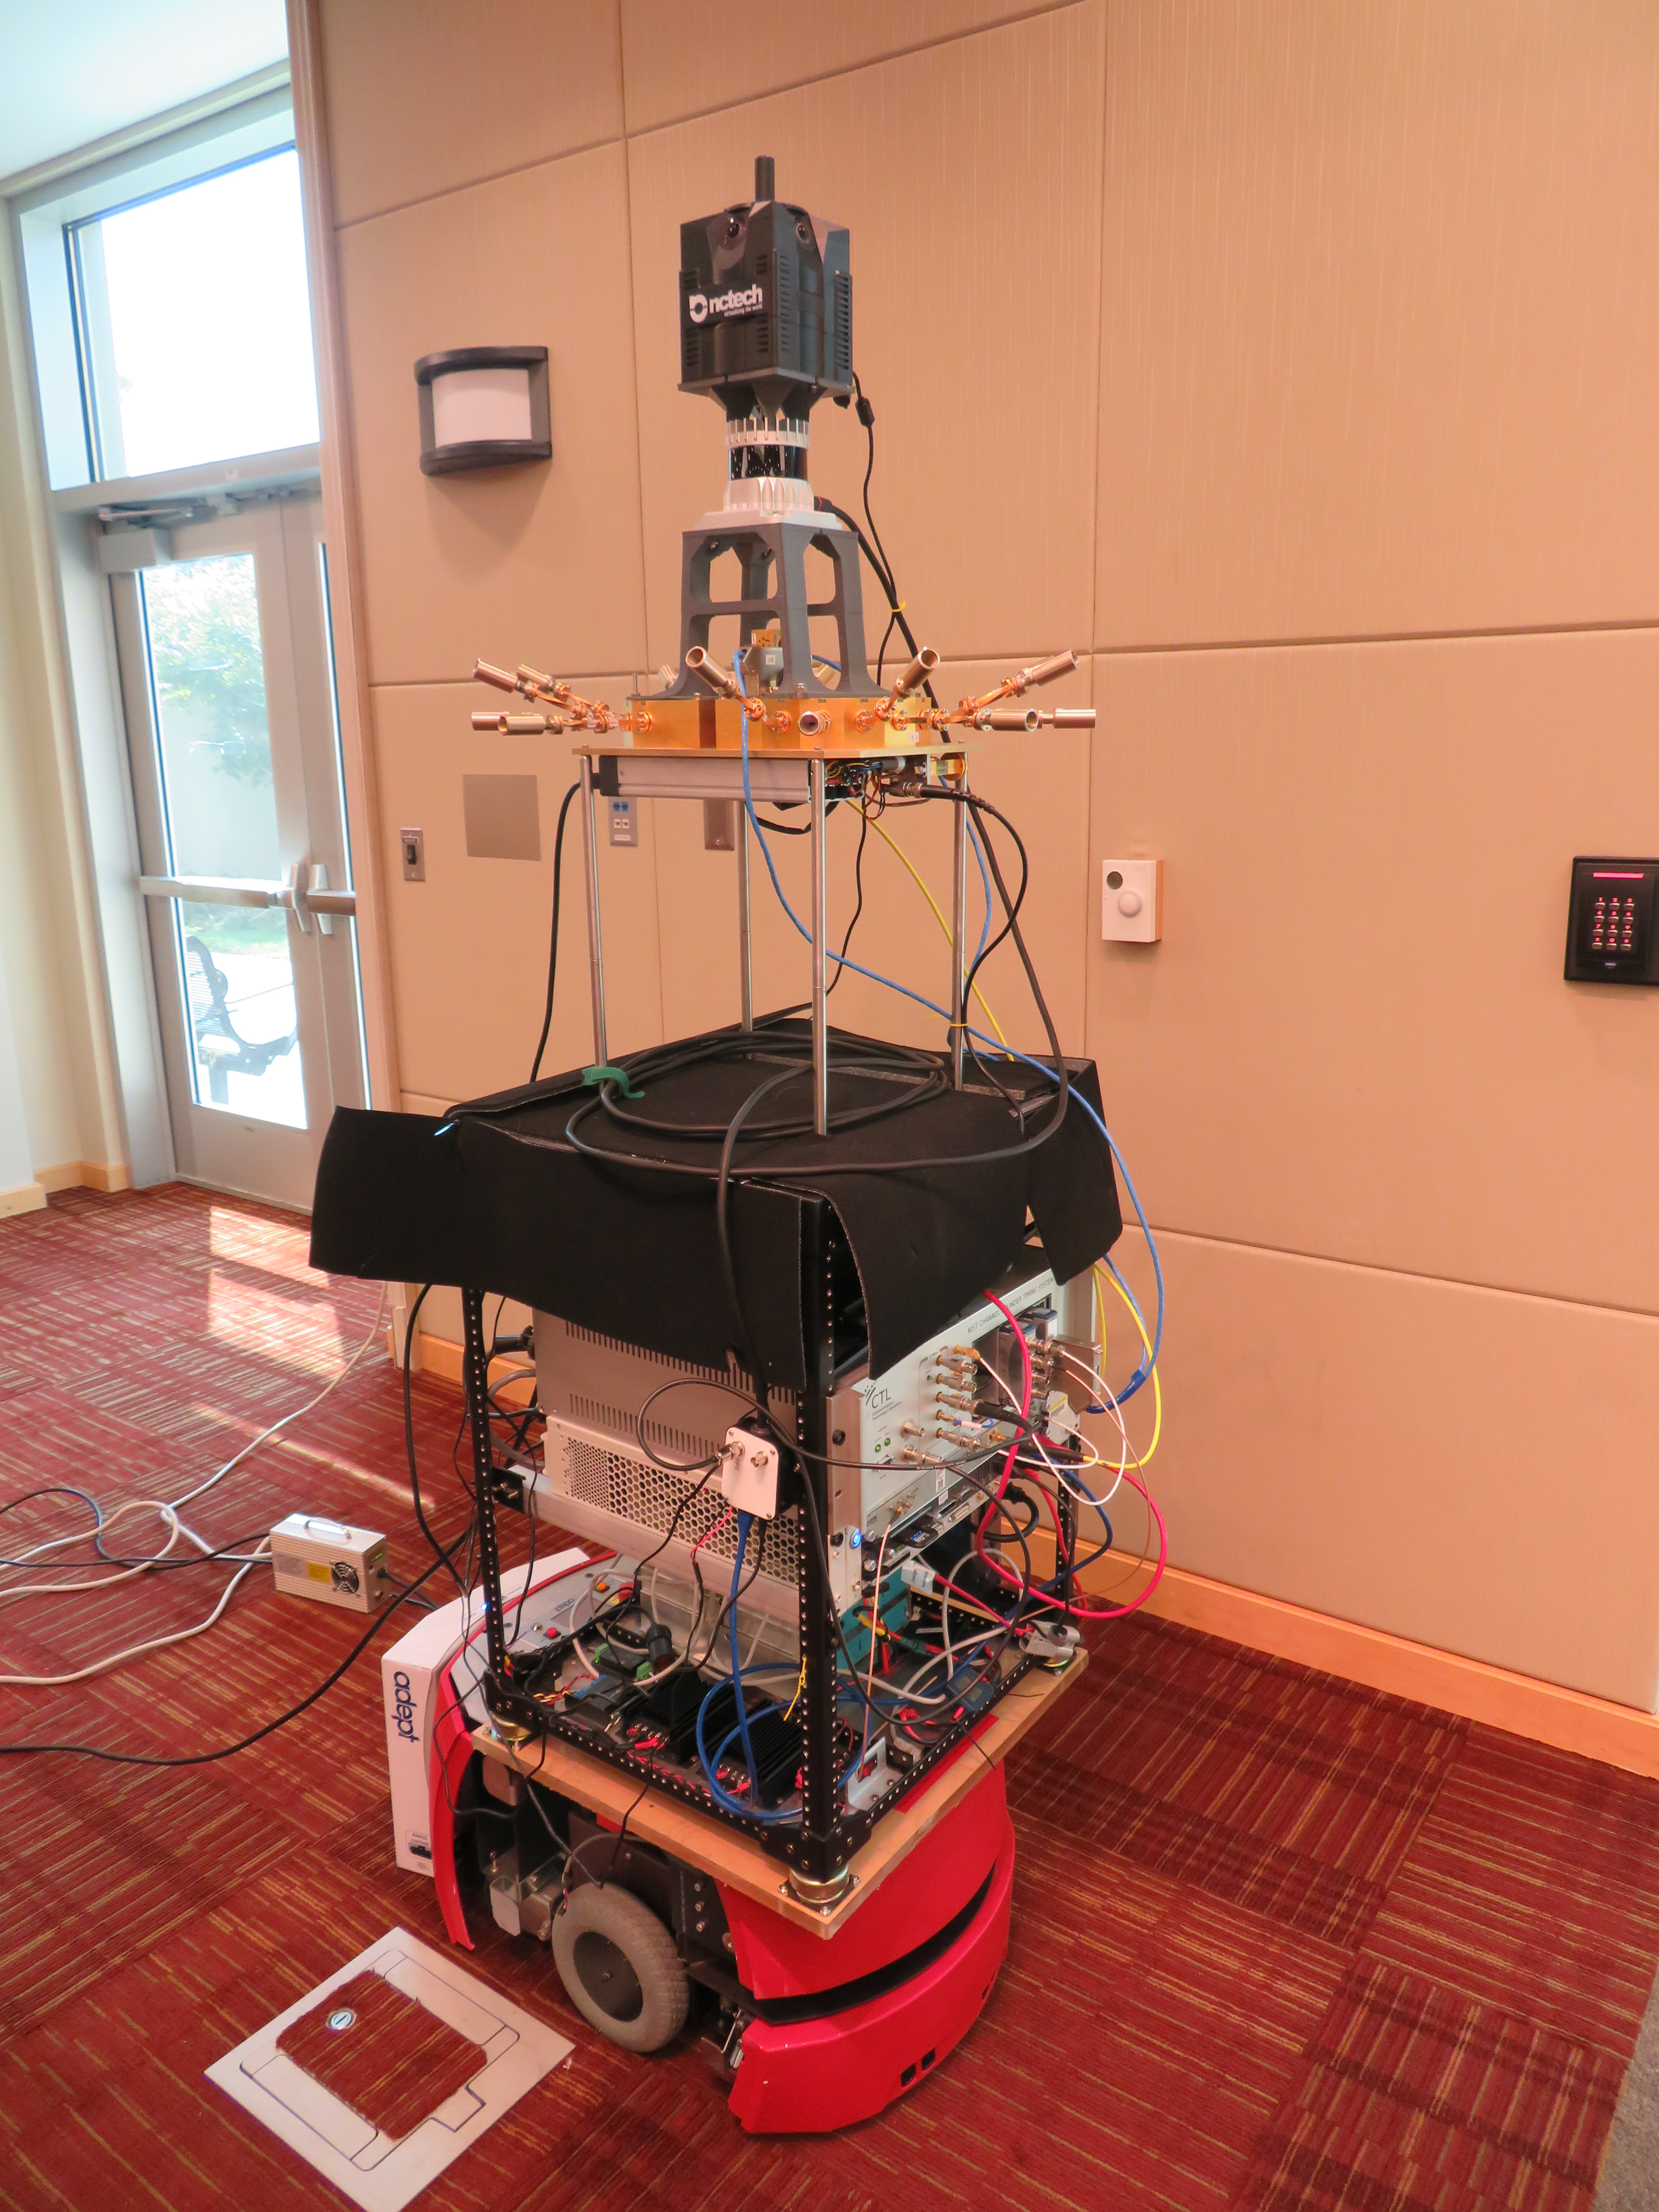
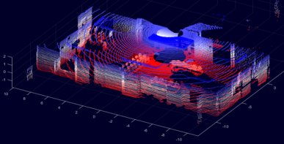
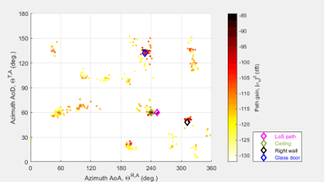
Measurement System & Data Collection
360° Camera
360° Lidar
Antenna array
While in motion, the receiver collected: RF data, 360° lidar data, and 360° photos of the environment.
Receiver

Slide 16
ITU AI/ML in 5G challenge

Slide 17
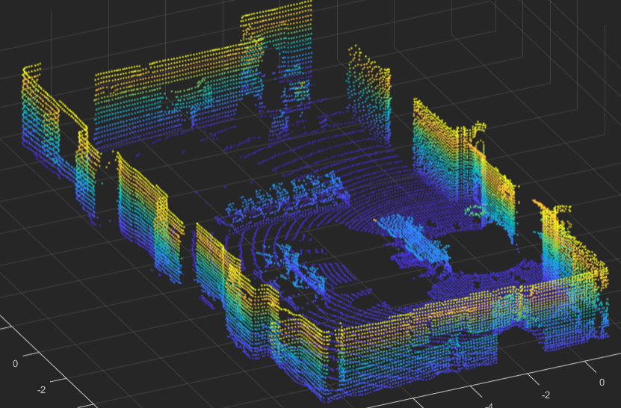
Depth Map estimation using mm-wave+ML
Two MIMO nodes
One fixed transmitter
One moving (position and orientation) receiver
Observation of environment changes over time
Relative to position and orientation of the receiver
Challenge: estimate the depth map of the environment at each receiver position, using mm-wave signals.
Physical world
Digital world

Slide 18
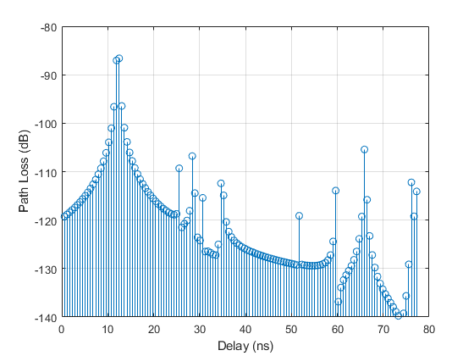
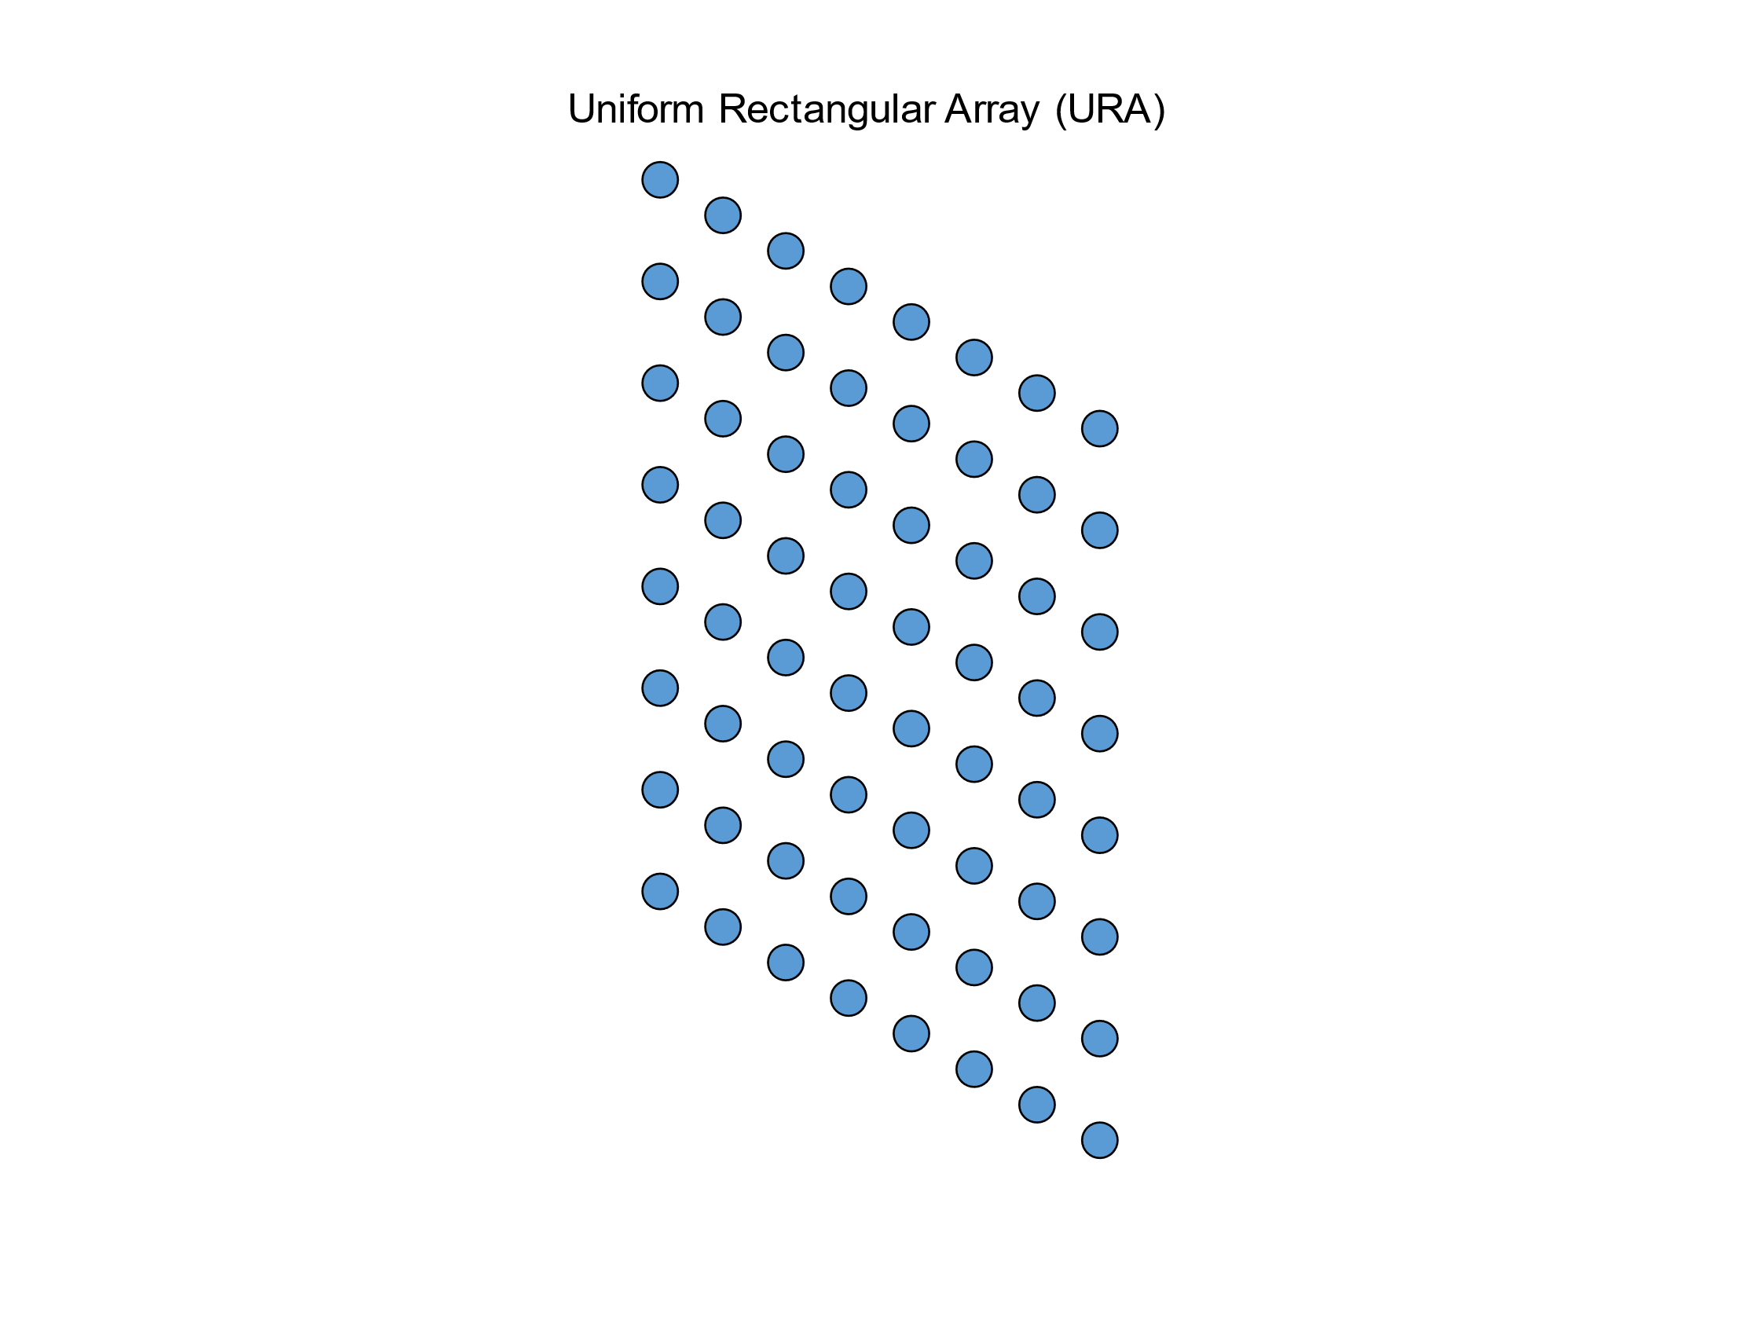

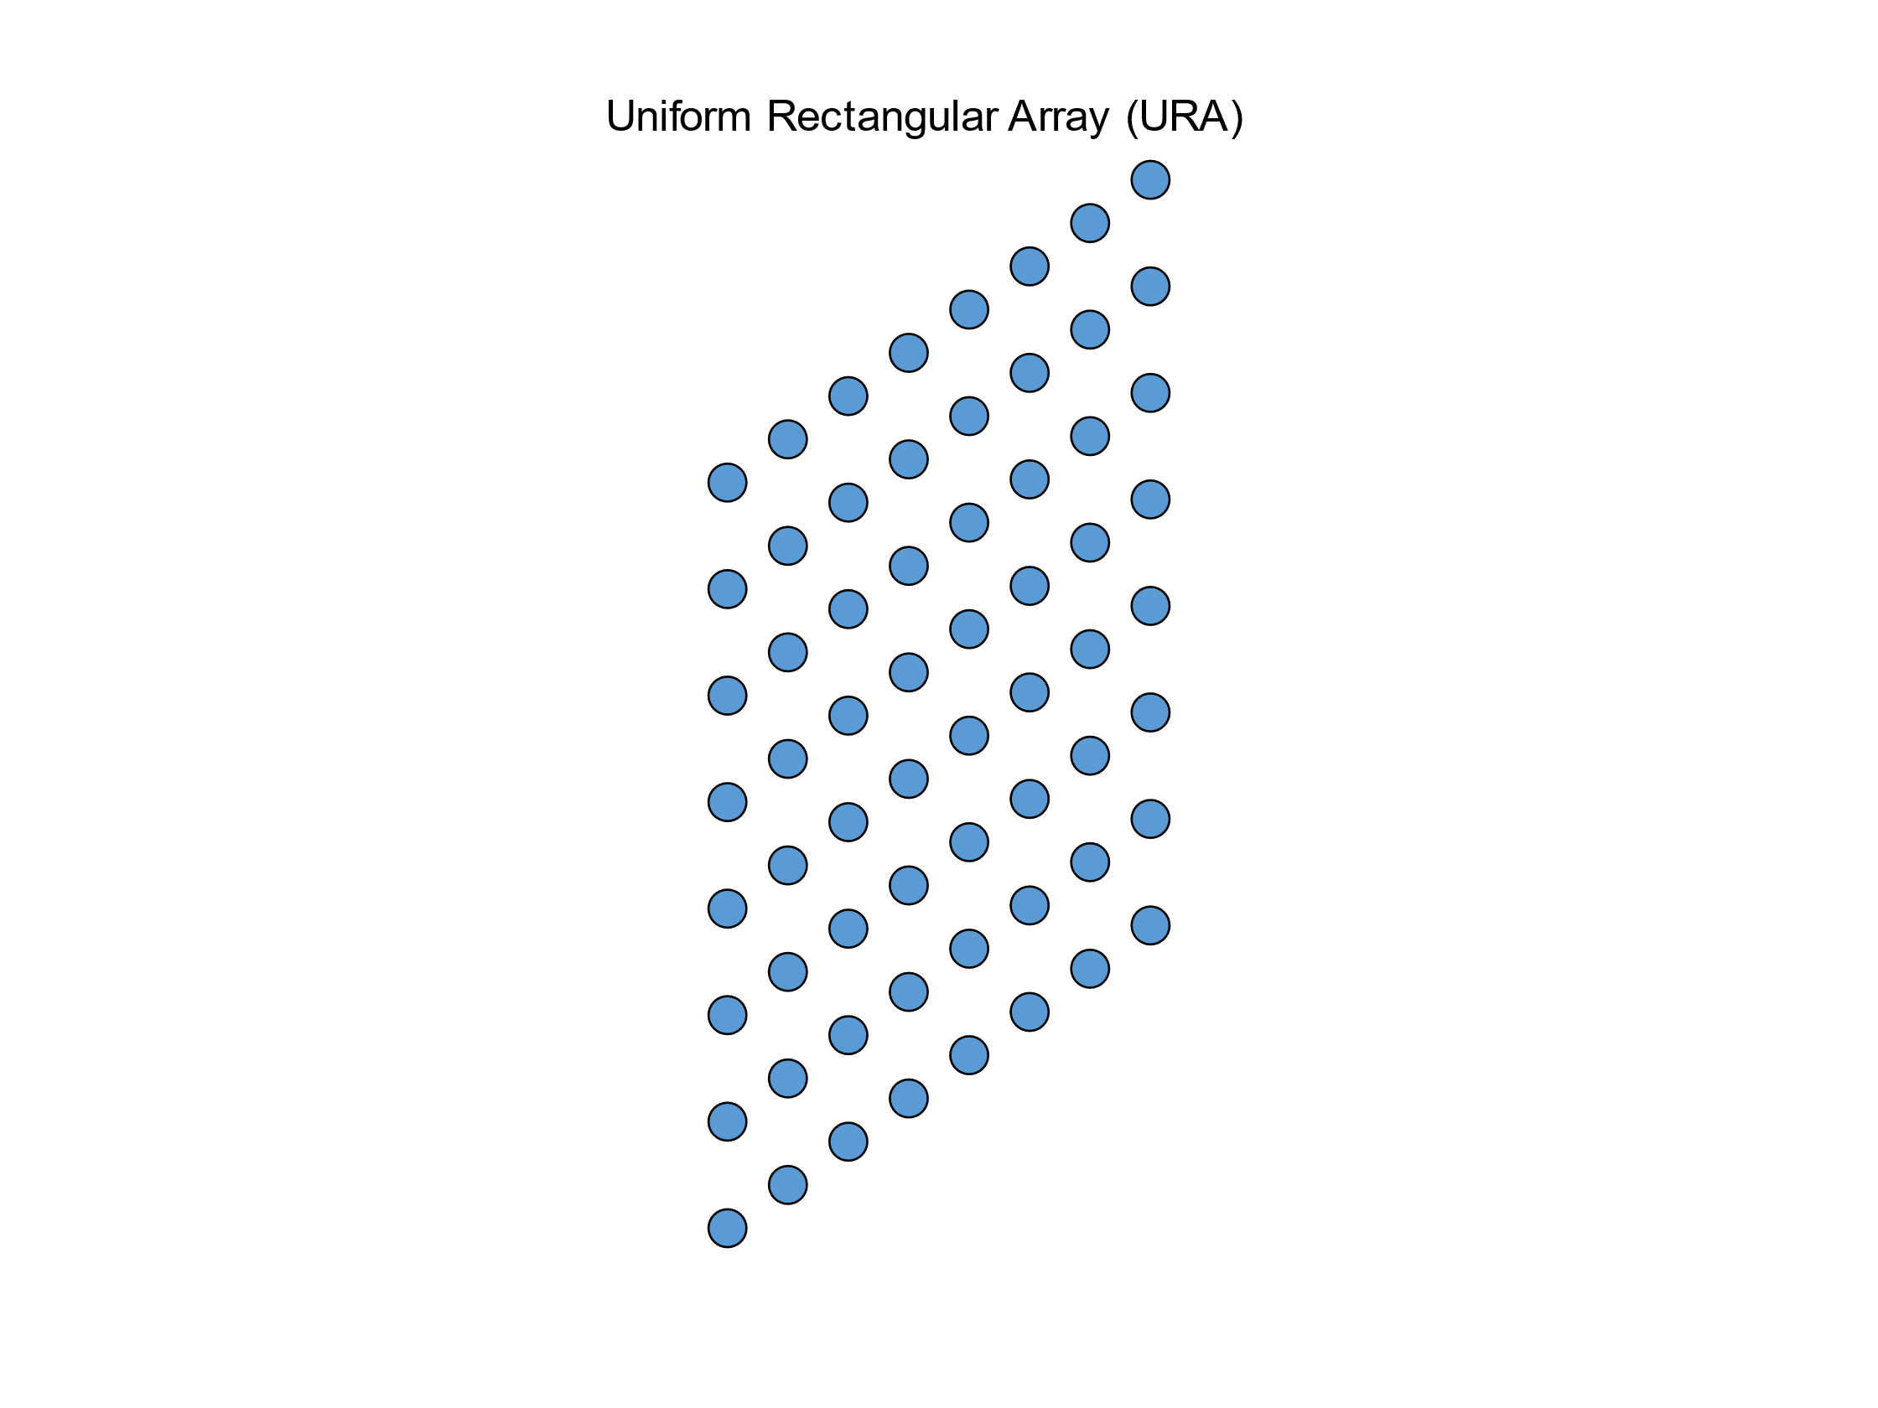
MIMO channel impulse response
RX
8×8
TX
8×8

Slide 19
Challenge overview
Lidar
^{Performance evaluation}
MIMO
Channel
ML/AI model

Slide 20
Training the model
Ground Truth: Training LiDAR dataset
Machine-Learning
^{Training Dataset}
Trained Model
Input Data: Training RF Dataset

Slide 21
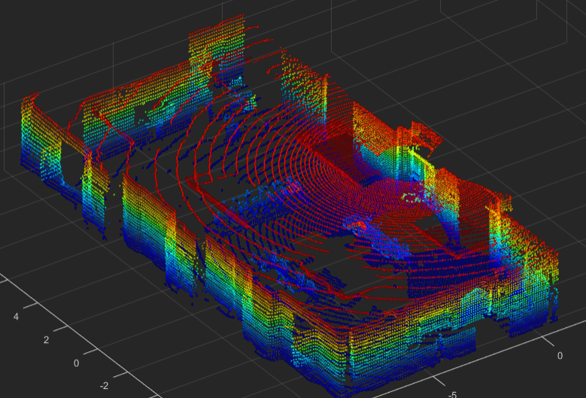
Evaluation of the model
Ground Truth: LiDAR Evaluation dataset
Trained Model
Input Data: RF Data Evaluation Dataset
Output: LiDAR Point Clouds
Evaluation
Training and evaluation dataset are collected in different areas of the room

Slide 22
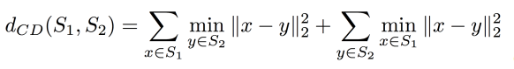


Evaluation metric: Chamfer Distance
Chamfer Distance measures discrepancies between point clouds.

Slide 23


Guest Researcher position at NIST
Ranking: based on average (over different positions) Chamfer Distance
Prize: guest researcher position at NIST

Slide 24
DataSET and File format

Slide 25
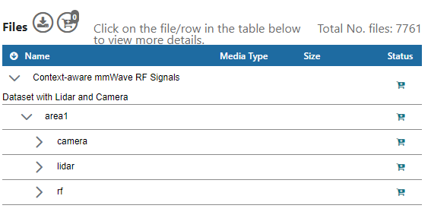
Dataset
Training dataset (Area1): "Context-aware mmWave RF Signals Dataset with Lidar and Camera"
Dataset website: https://datapub.nist.gov/od/id/mds2-2645
Challenge and dataset related code @GitHub: https://github.com/usnistgov/ML5G-PS-004
File Naming:
FileTypePrefix_<X*10^6+Index>.ext, where FileTypePrefix refers to the type of the file, X is area number, Index=[0, 1, 2, ….., N-1], N is number of cases, and ext is the file extension (mat, pcd, jpg).

Slide 26
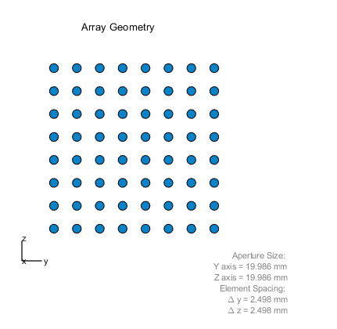
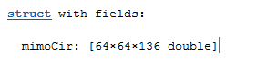
RF data file format
MIMO CIR format: .mat
Rx antennas × Tx antennas × Delay taps
Delay sampled at 1.76GHz

Slide 27
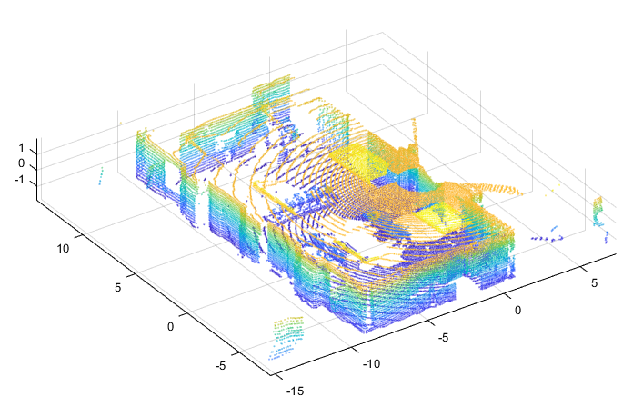
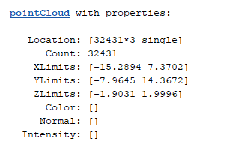
Lidar file format
Lidar type: Ouster OS0-128
Point cloud file format: PCD (binary) https://pointclouds.org/documentation/tutorials/pcd_file_format.html
Point cloud data format: Unorganized and downsampled
Datatype: Single (f32)
How to read point cloud data:
MATLAB ( recommended 2020b or newer)
Python, e.g. Open3d and pyntcloud
Example:

Slide 28
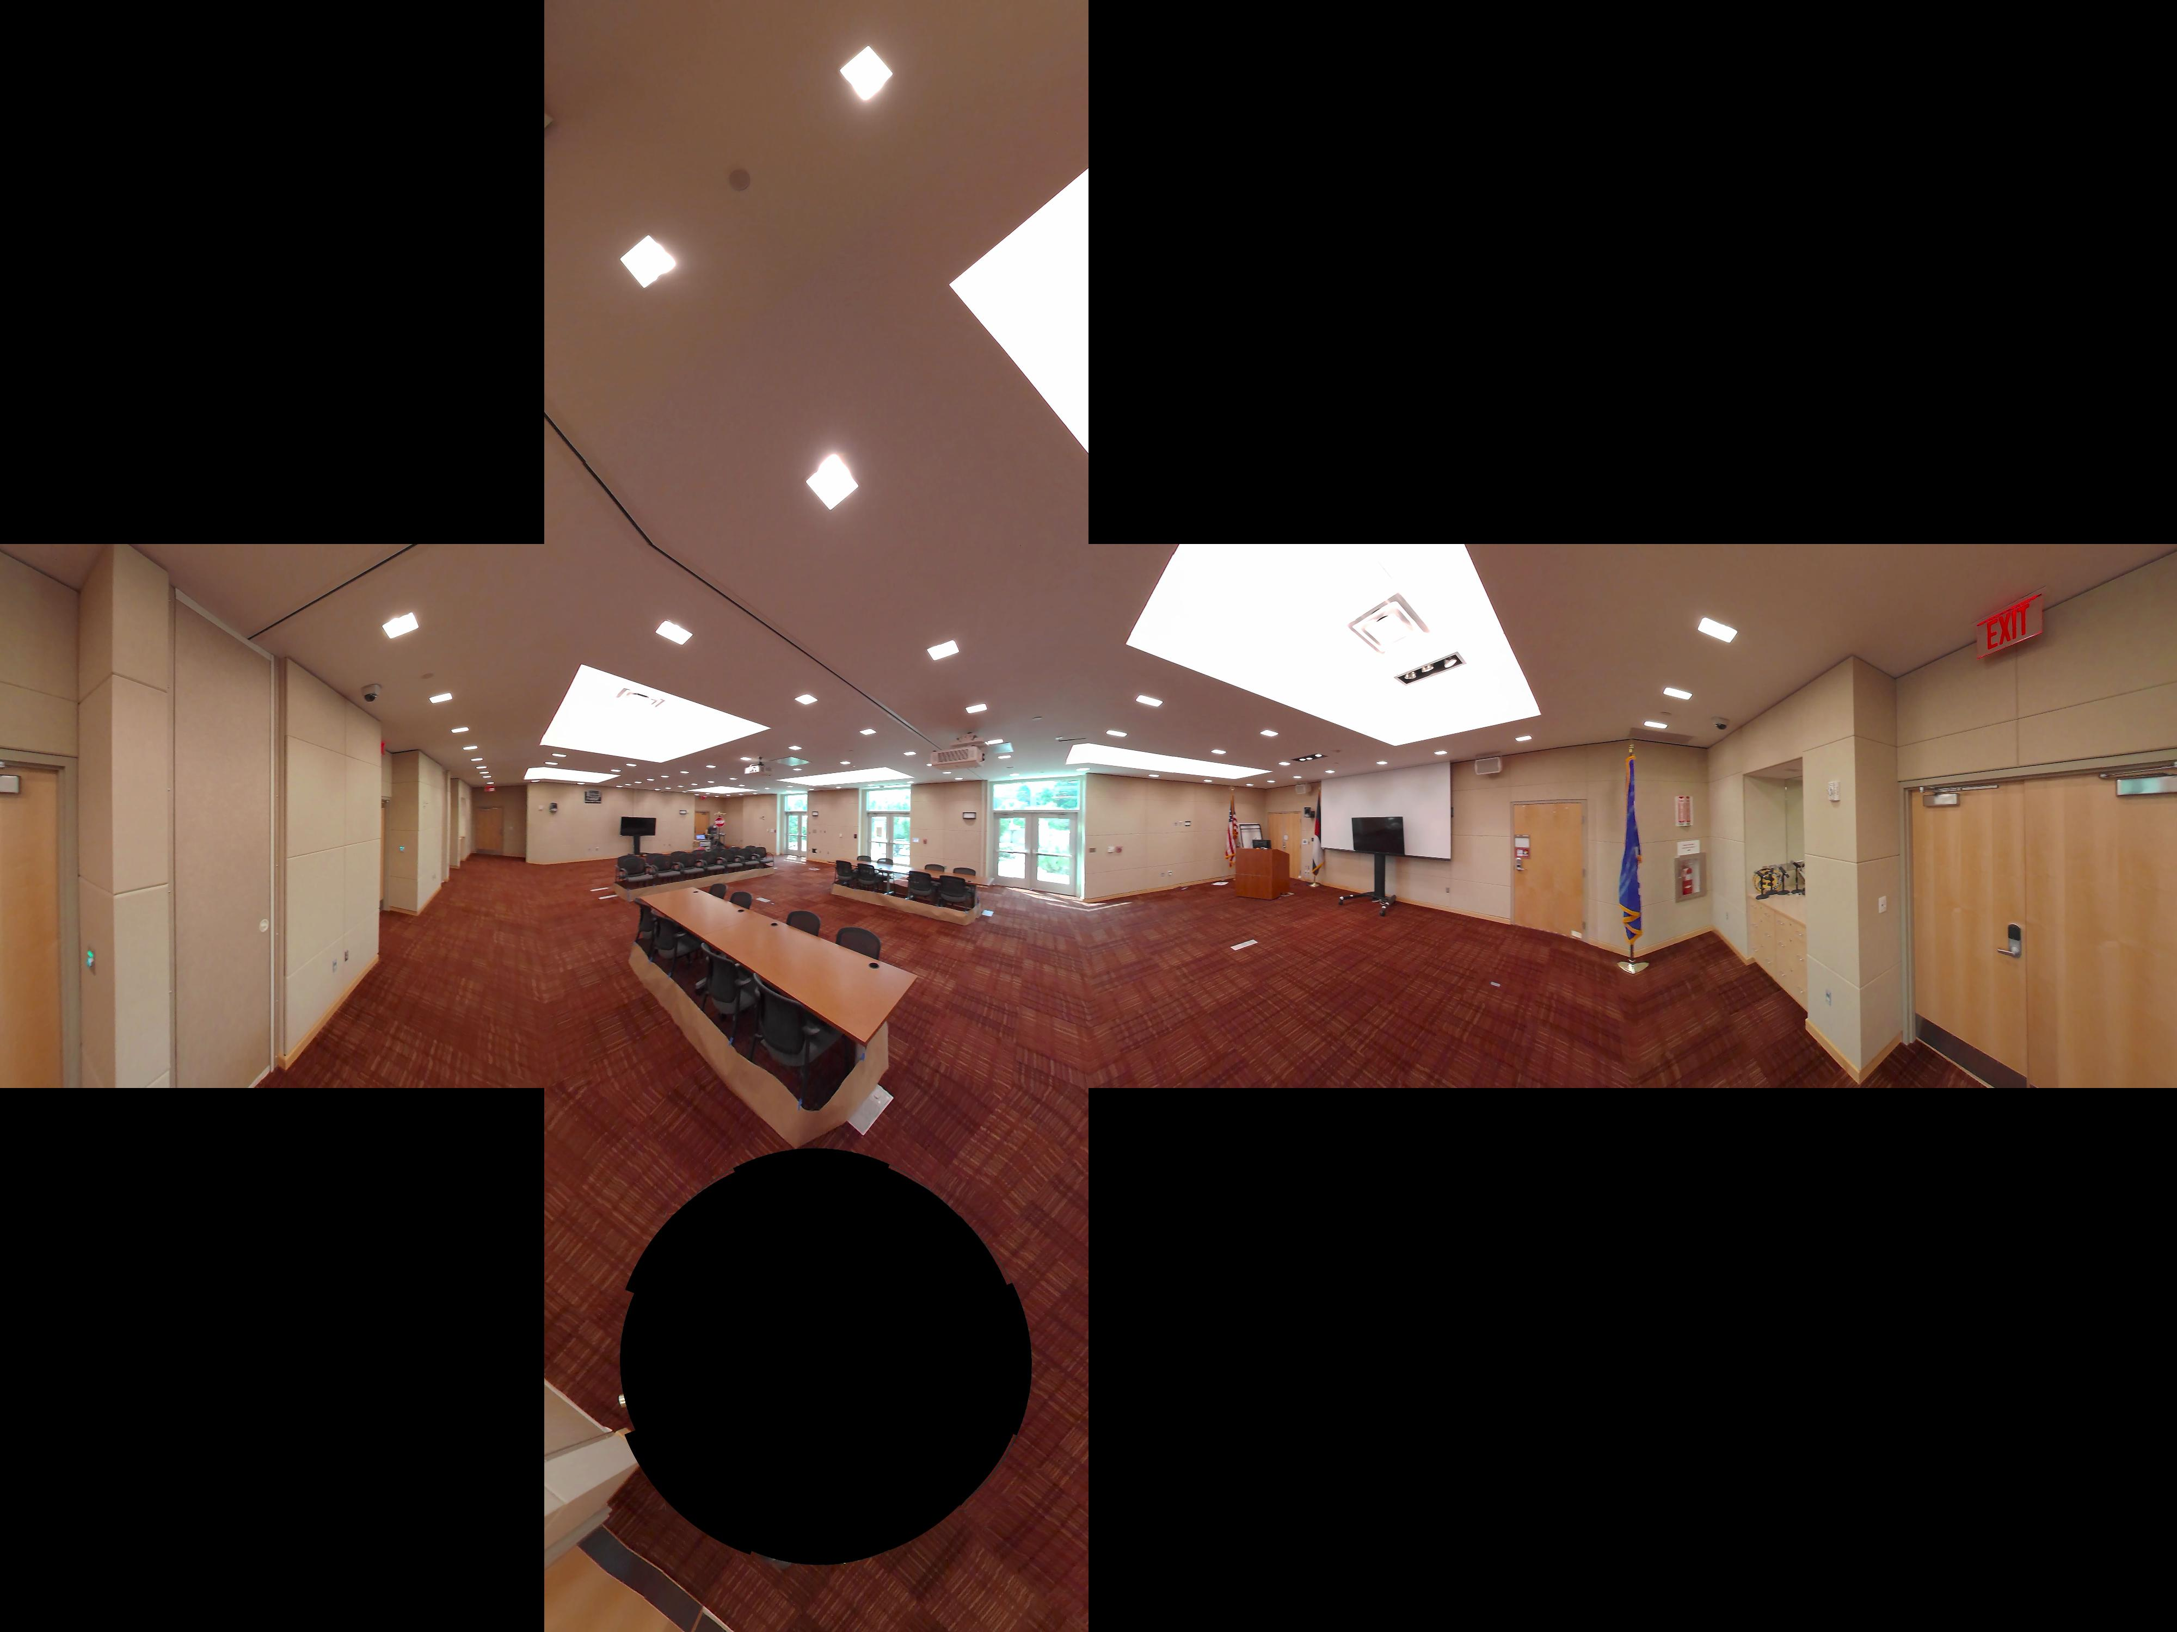
Image file format
Image resolution: 11000x5500
File type: JPG
Projection: 360 image, Equirectangular
Cubemap projection
Equirectangular projection

Slide 29
Bonus
3D Environment Parsing and Reconstruction

Slide 30
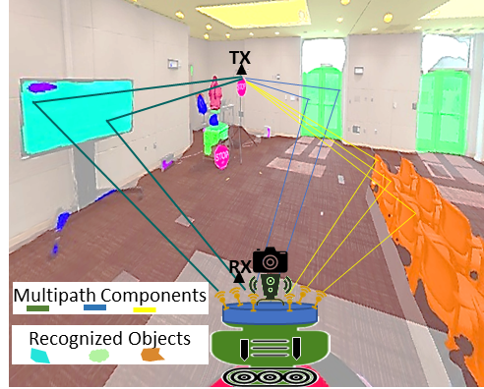
Channel Modeling
Context-aware RF measurement system
Accurate channel models → Reliable designs of wireless systems → Accelerate the deployment of nextG wireless systems
Machine learning enables fast processing of large volumes of data for accurate channel modeling
Environment parsing via object recognition and segmentation
Automated 3d modeling of the environment
Automate the mapping of the multipath components to the objects
Predict channel models of new environment from 3d models

Slide 31
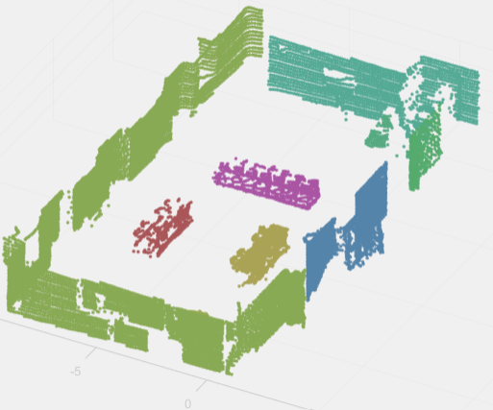
3D Environment Reconstruction: Modeling
1
Object Recognition
Semantic segmentation
Panoptic segmentation
Point cloud semantic
segmentation
Depth map estimation
Simultaneous Localization
and Mapping (SLAM)
2
3
Camera-LiDAR Sensor
Fusion
3D modeling
Example: B. Pitzer, S. Kammel, C. Duhadway and J. Becker, "Automatic reconstruction of textured 3D models," 2010 IEEE International Conference on Robotics and Automation, 2010, pp. 3486-3493.

Slide 32
3D Environment Reconstruction: Evaluation
Point-based qualitative evaluation (30 points Total)
Ideal solution: Automatic generation of the 3d MAP of the environment with material definition of every object. E.g. Wavefront OBJ and Material Template Library (MTL)
Subproblem solutions evaluation:
Subproblem solution | Points
1. Image-based machine learning algorithms | 0-15
2. Point cloud algorithms | 0-10
3. Sensor fusion and 3d Modeling | 0-5
Total | 0-30

Slide 33
Guest Researcher position at NIST
Ranking: Point-based qualitative ranking
Prize: guest researcher position at NIST

Slide 34
Create a sustainable digital world
Future generation network will support unprecedented variety of applications, pervading every aspect of human life.
Data acquisition and processing, while keeping low cost and power, is one of the biggest challenge to overcome
Exploiting as much as possible the resources that we already have is vital to sustain future networks.
We challenge participants to contribute to the realization of future sustainable networks:
Leveraging RF signals, estimate the depth map of an environment
As a bonus, utilize lidar and images to parse and reconstruct the environment

Slide 35
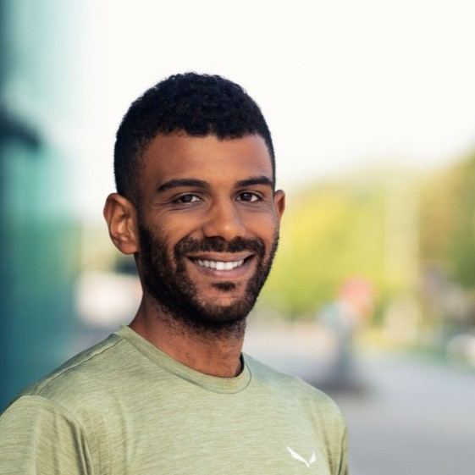

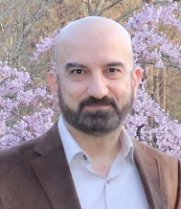
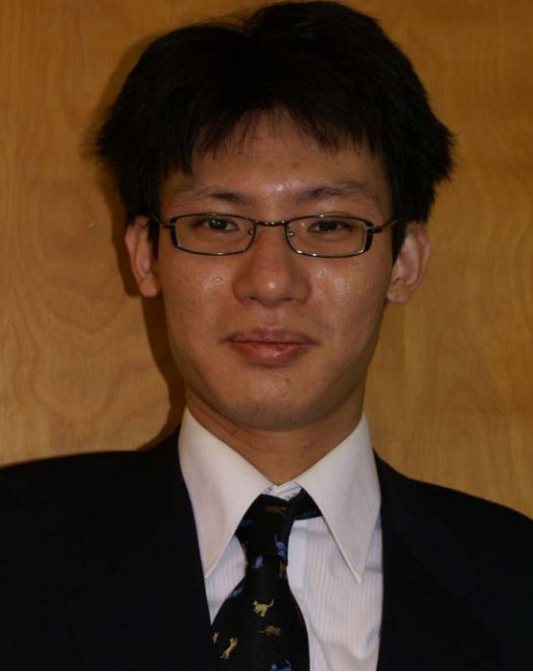
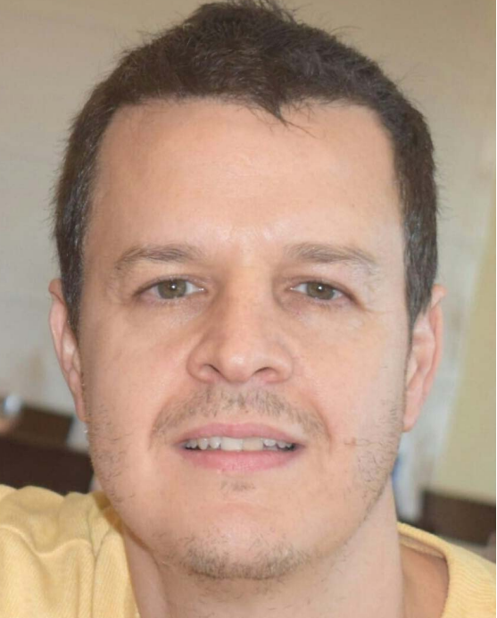
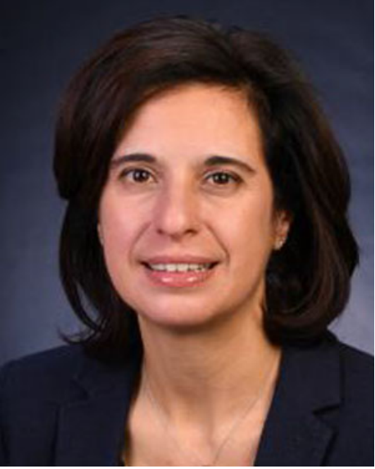

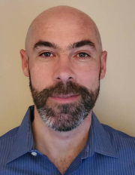
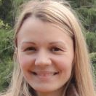
Team
Steve Blandino
Anuraag Bodi
Raied Caromi
Jack Chuang
Camillo Gentile
Nada Golmie
Chiehping Lai
Tanguy Ropitault
Jelena Senic

Slide 36
Questions?
steve.blandino@nist.gov

